Slide 1
MA679
Physical Therapy Project
Week 1 Update: EDA
William Zen, Zara Waheed, Pruthvi Bharadwaj

Slide 2
Project Introduction
Osteoarthritis study to check if intervention is needed
Force plates used to measure the multidimensional impact of the force on a person’s knee.
Participants = 2291 participants
4 trials on each leg
Goal: Dimension reduction to locate the most important elements.
Notes:
The project is based on a study of Osteoarthritis patients for the purpose of early intervention.
A study was conducted using force plates to measure the multidimensional impact of the ground’s force on a person’s knee.
Ultimately, the client wanted to know if we can use dimension reduction to locate the most important elements and develop features

Slide 3
Data Summary
Participants
2291
#Trials | #Participants
1 | 2
2 | 13
3 | 36
4 | 246
5 | 1979
6 | 12
7 | 3
Total IDs:
KNEE | #Trials
LEFT | 7862
RIGHT | 7834
Unique IDs:
KNEE | #Participants
LEFT | 2275
RIGHT | 2270
Notes:
First we looked at some summary statistics of the data:
For 2291 participants

Slide 4
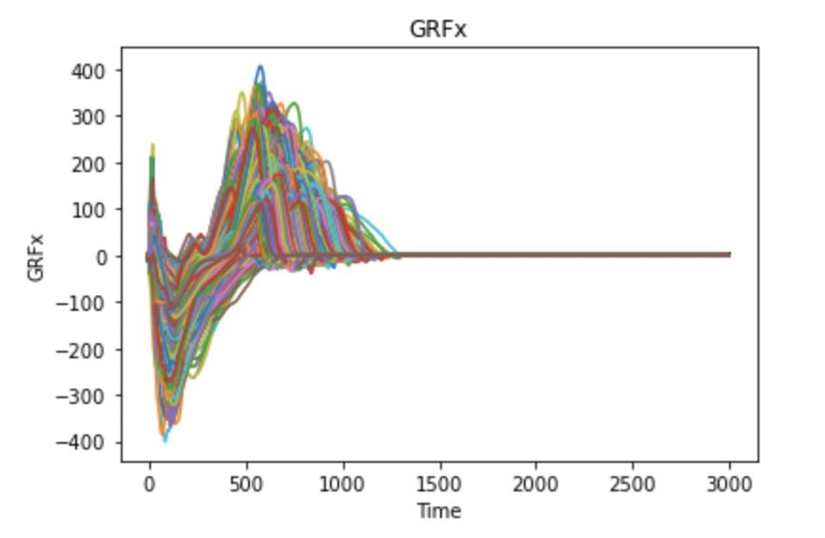
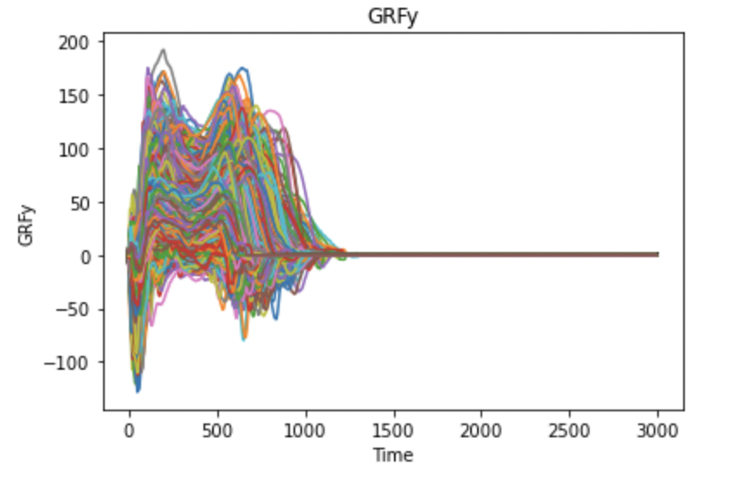
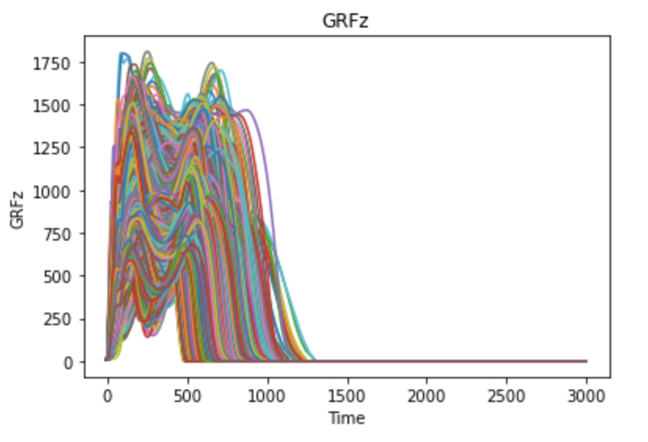
Replication of time series plots
Notes:
We replicated the time series plots that were provided by Kerry. These show the Ground reaction force in x y and z dimensions over about 3000 time points
Each observation represents a trial, x shows the time and y shows the GRF

Slide 5
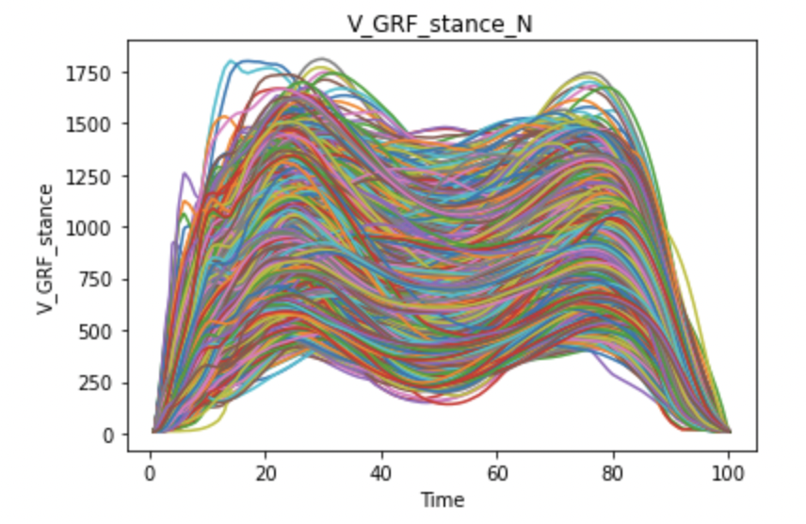
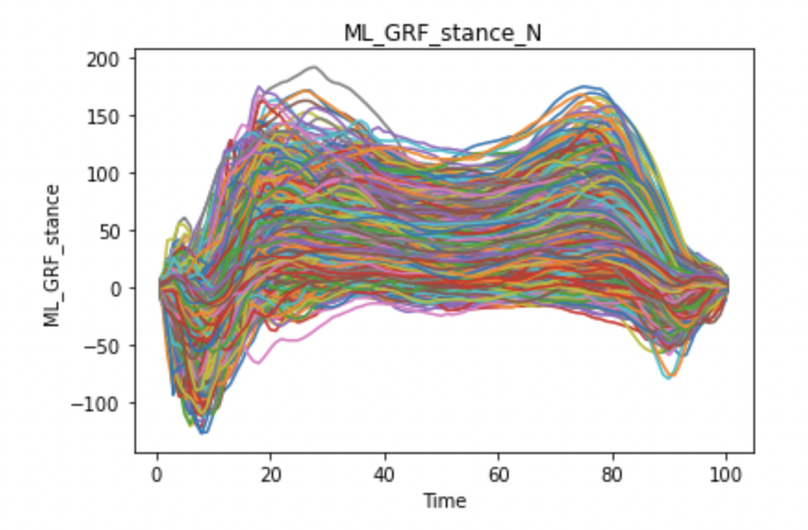
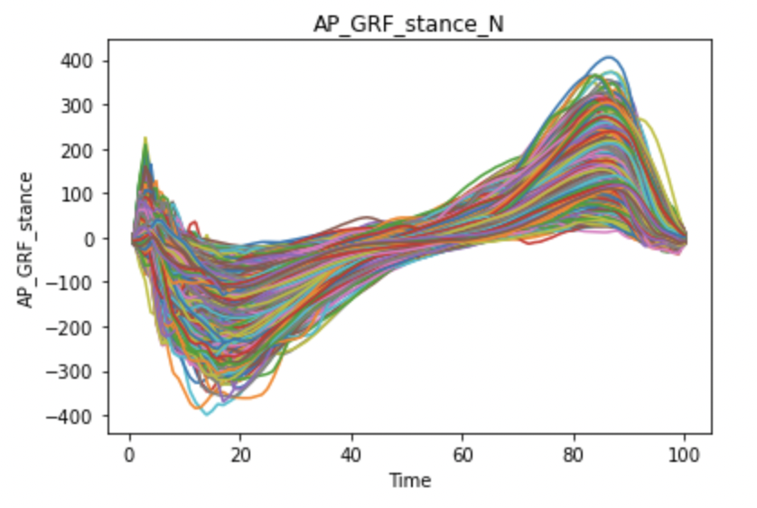
Replication of time series plots
Notes:
The stance plots are much easier to understand as they have been time normalised.

Slide 6
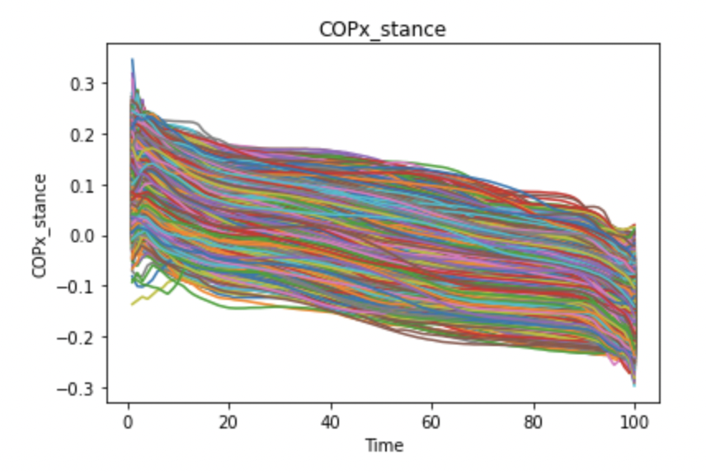
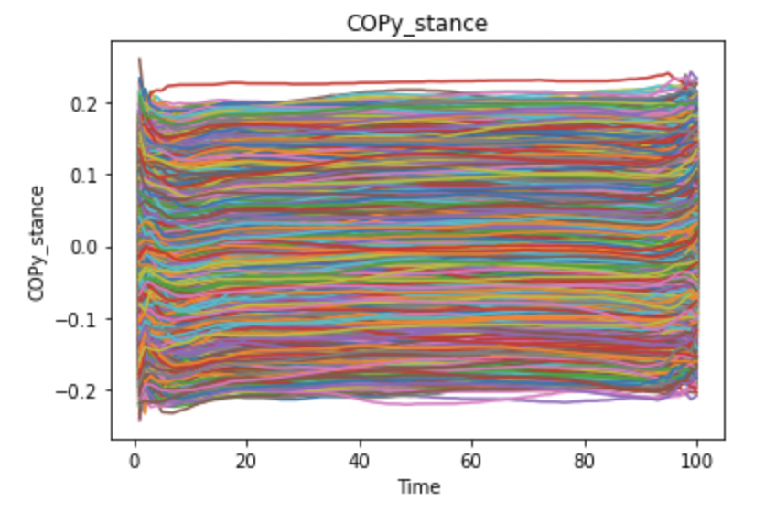
Replication of time series plots
Notes:
The COP seems to start in the front of the foots and shift towards the back whereas, in the y dimensions it stays pretty much constant.

Slide 7
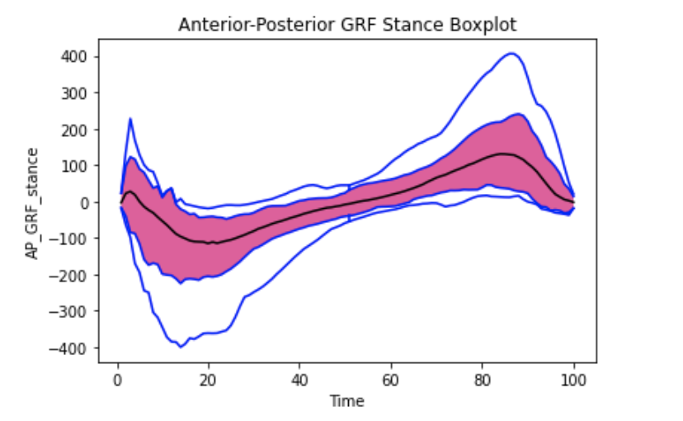
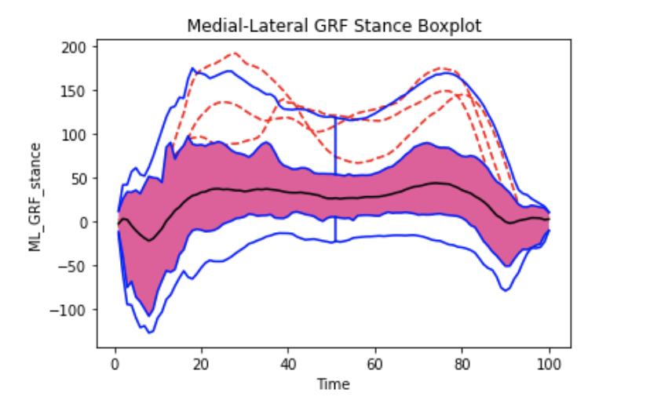
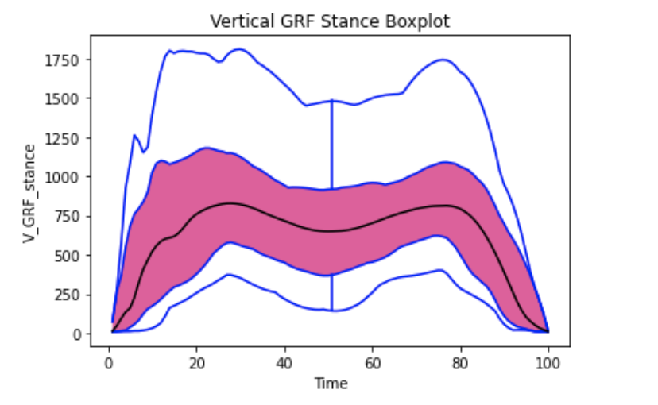
Time series box plots - GRF
Notes:
We then created some time series box plots with outliers for the stance variables.
We can observe in the boxplot the median in black, the central region (where the 50% of our observations lie) is in pink and the envelopes and vertical lines in blue. The outliers detected are represented with a red dashed line.

Slide 8
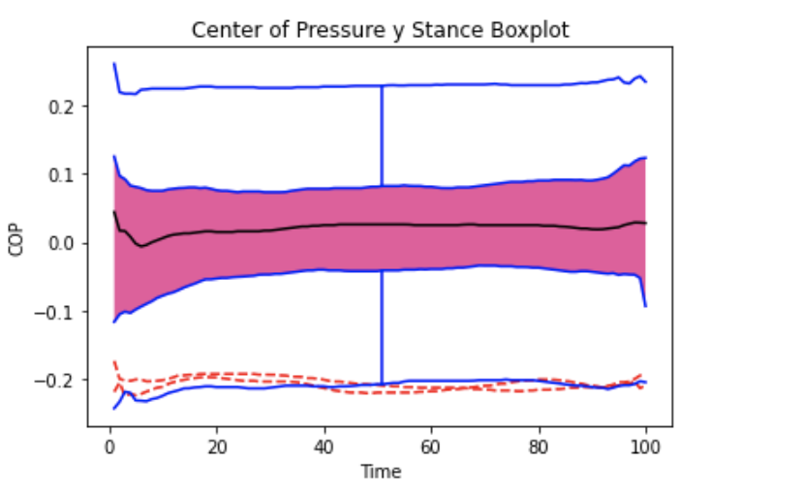
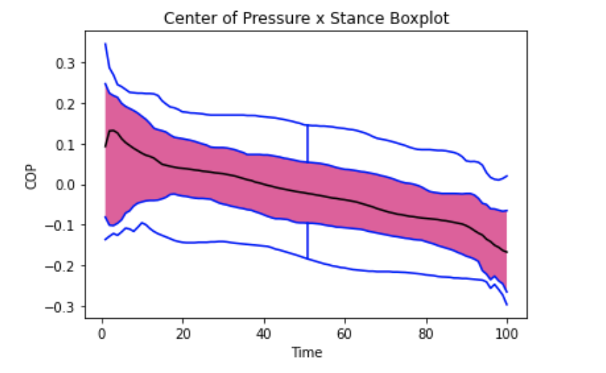
Time series box plots - COP
Notes:
We can see that no outliers are detected for x and z dimensions. These are initial plots and the outliers are detected through some predefined threshold or method that we are yet to explore. This can be altered and we can play around with it to determine what would be the appropriate outlier technique for our case

Slide 9
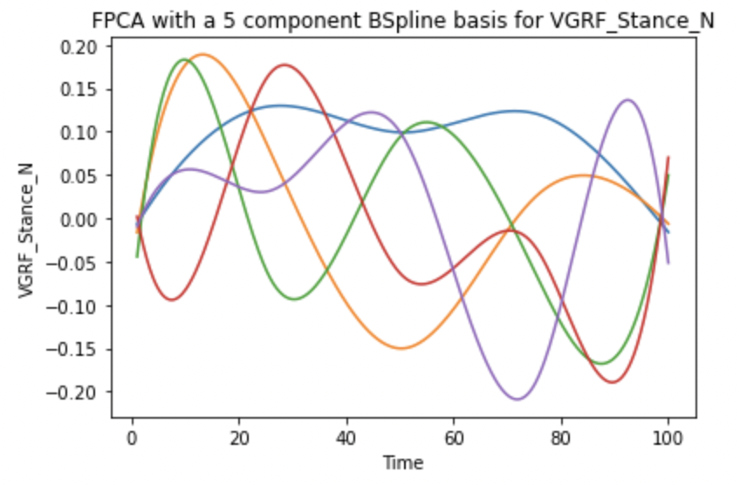
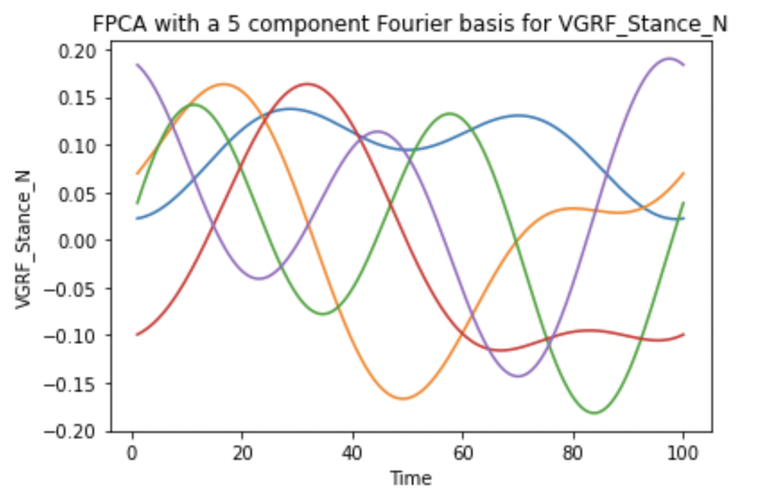
FPCA
Component Number | %Variance explained
1 | 80.4%
2 | 12.9%
3 | 3.4%
4 | 1.7%
5 | 1.3%
Component Number | %Variance explained
1 | 81.7%
2 | 12.6%
3 | 3.2%
4 | 1.5%
5 | 1.1%
Notes:
Then we tried some functional principal component analysis plots . We tried using BSplines as shown in the first plot and we also tried Fourier basis since it seemed to be worth exploring since our observations seem to be sinusoidal in nature. However, these are still a work in progress and we are still trying to figure them out.

Slide 10
Learning Outcomes
Working with functional data in Python
Basis representation of functional data
A basic understanding of FPCA
Explored discrete dataset with histograms and correlation plots
Notes:
Overall the first week proved to be a great learning curve, we worked on understanding functional data and learning how to represent is using FPCA. We also did some exploring and visualization of the discrete dataset

Slide 11
Next Steps
Dimensionality Reduction techniques
RKHSVariableSelection
Recursive Maxima Hunting
FPCA
Deep Learning
Autoencoders
Refine Outlier detection technique
Notes:
Moving on we want to dig deeper into dimensionality reduction techniques, Maybe try Deep learning tools such as autoencoders.

